Slide 1


Entity Identification in Bitcoin
Project by:
Afshan Anam Saeed
Migle Kasetaite
Nidhi Agrawal
Sanjana Warambhey

Slide 2

What is Bitcoin?
Project Overview
Introduction
Methodology
Result

Slide 3

What is Bitcoin?
Decentralized digital currency of the Electronic Payment System
Uses Peer-to-Peer technology
Maintains pseudo anonymity of Users
Effective against counterfeits
Being misused for illegitimate activities
Therefore, requirement for User Identification

Slide 4

Project Overview
Generate undirected, weighted Address Correspondence Networks
Identify entities by using Community Detection algorithms on the networks
Compare the effectiveness of our algorithm with the Ground Truth

Slide 5

Introduction
Blockchain is a digitally distributed public ledger
Bitcoins Networks are based on the Blockchain
Address: Unique identification of location for sending and receiving Bitcoin
Input, Output and Change Addresses are defined by users
Entity: Users that transfer Bitcoins from one address to another
Transactions: The process of transfer of Bitcoins from one address to another
Unique addresses are generated for each transaction
Addresses are responsible for maintaining the pseudo anonymity of Bitcoins.

Slide 6
Heuristics
Heuristics detect relationships amongst different addresses. The heuristics used are:
Multi-Input (h0- Baseline)
Change Address Type
Change Address Behavior
Change Lock time
Optimal Change
Peeling Chain
Power of 10

Slide 7

Data
Two datasets are provided for transactions in each year 2012 and 2014.
The Data contains:
Input address
Output address
Count for each heuristic
Ground Truth dataset – Contains details of known addresses and their known entities

Slide 8
Methodology
Transaction Sampling Process
Address Correspondence Network Construction
Address Correspondence Network Clustering
Cluster Quality Analysis

Slide 9
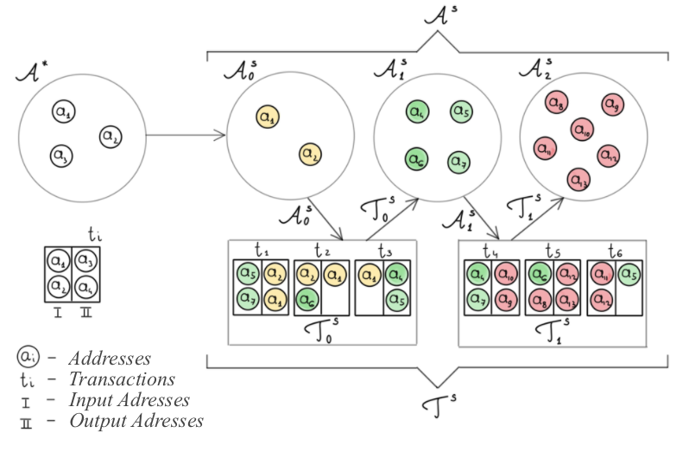
Transaction Sampling Process

Slide 10

Address Correspondence Network
Defines the existence of relationships between addresses based on how often they get detected by the heuristics.
It is an undirected, weighted Network where:
Nodes: Addresses used in transactions
Link: Two nodes are linked if they belong to the same entity
Weight: Number of times heuristics detected that the two nodes belong to the same entity

Slide 11

Address Correspondence Network Construction
Heuristics paired with h0 are used to construct the networks
Seven Address Correspondence Networks are obtained
- One where only h0 is considered
- Six others with each of six heuristics paired with h0
Weight in these networks are the sum of the values of h0 and its paired heuristic

Slide 12
Address Correspondence Network Clustering
The clustering was performed using the Label Propagation Algorithm (LPA)
Clustering finds similarities amongst nodes (addresses) to identify them to belong to a similar entity
Initialization of nodes in LPA is done using random entities from Ground Truth Data
Our results are based on different proportions of initialization of nodes

Slide 13

Cluster Quality Analysis
Metrics are used to compare cluster outputs with the ground truth labels:
Modularity: Gives information about the intrinsic quality of the clusters by comparing the clusters with a random baseline
Homogeneity: Measure that associates how ideal and homogenous the clusters are
Adjusted Mutual Information: Gives information obtained about any cluster in the clustering output by observing any other cluster within the output
Adjusted Rand Index: Computes the similarity between two data clustering

Slide 14
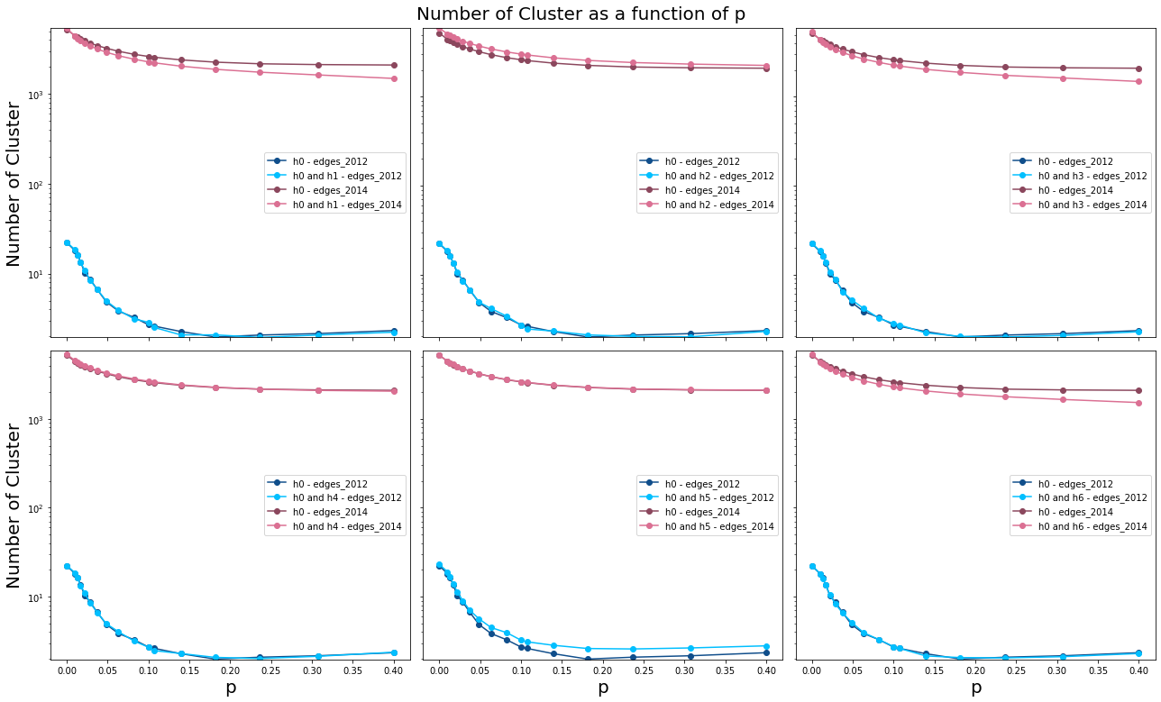
Results

Slide 15
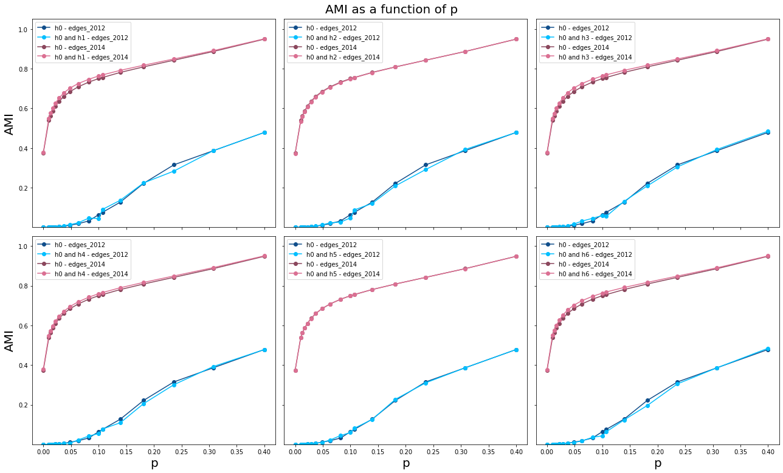

Slide 16
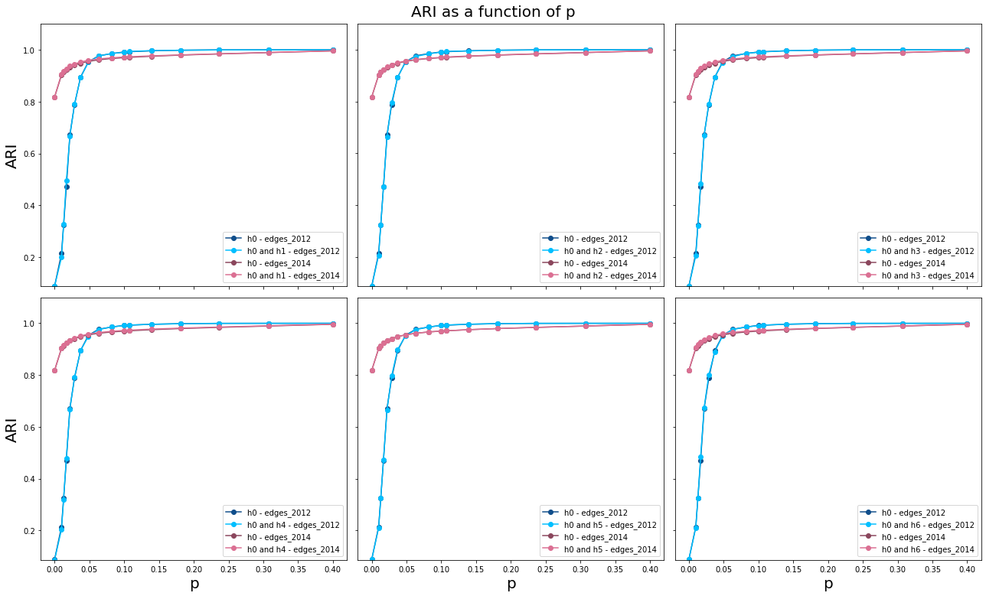

Slide 17
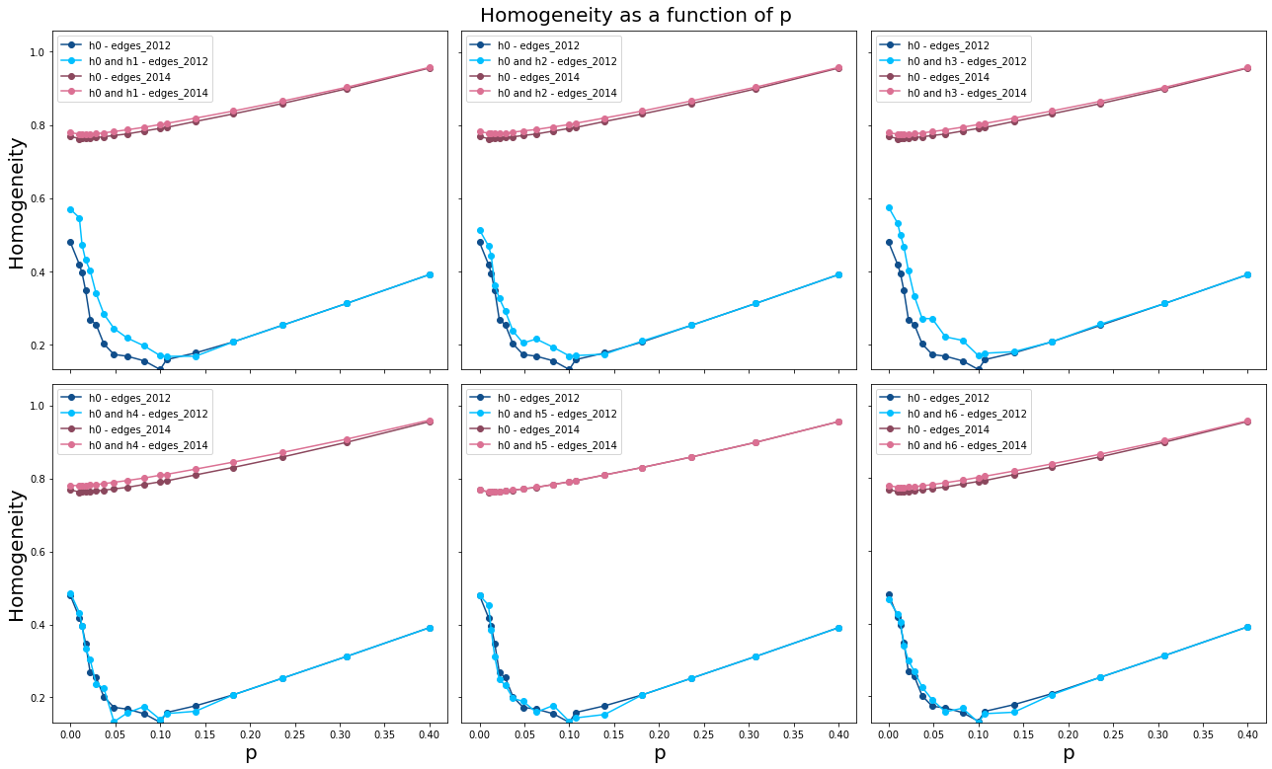

Slide 18
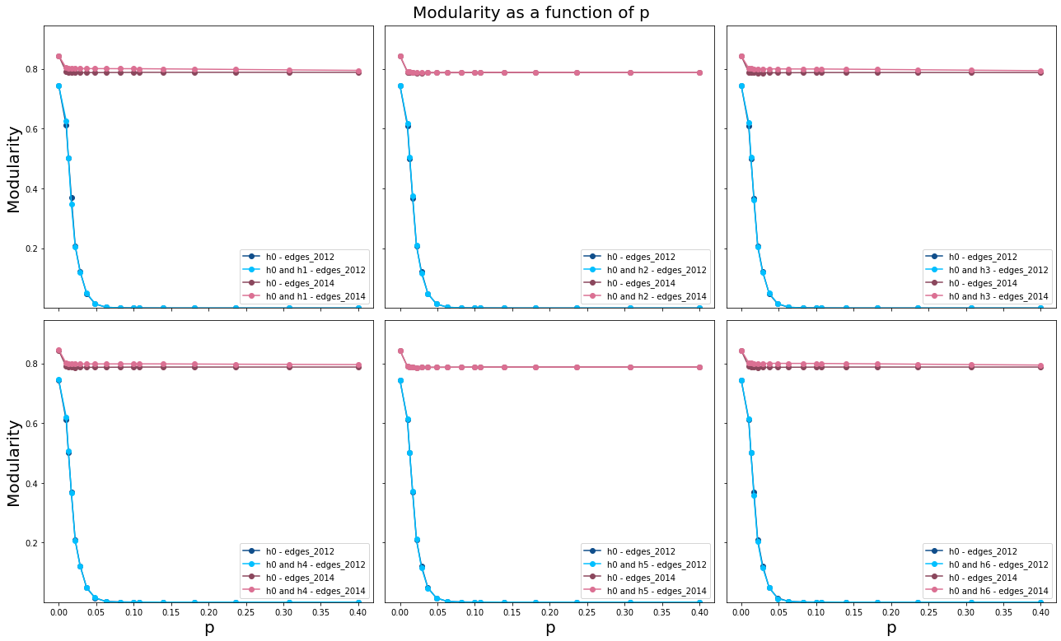

Slide 19
Conclusion
Pair of heuristic graphs show that the recognition of entities in our network is robust
01
Other heuristics, except multi-input baseline heuristic, with False Positives do not affect our result significantly
02
Small proportion of Ground Truth Data Set provides optimal results
03
Community detection is a viable method to identify entities in the Bitcoin network
04

Slide 20

Thank You!

